Slide 1
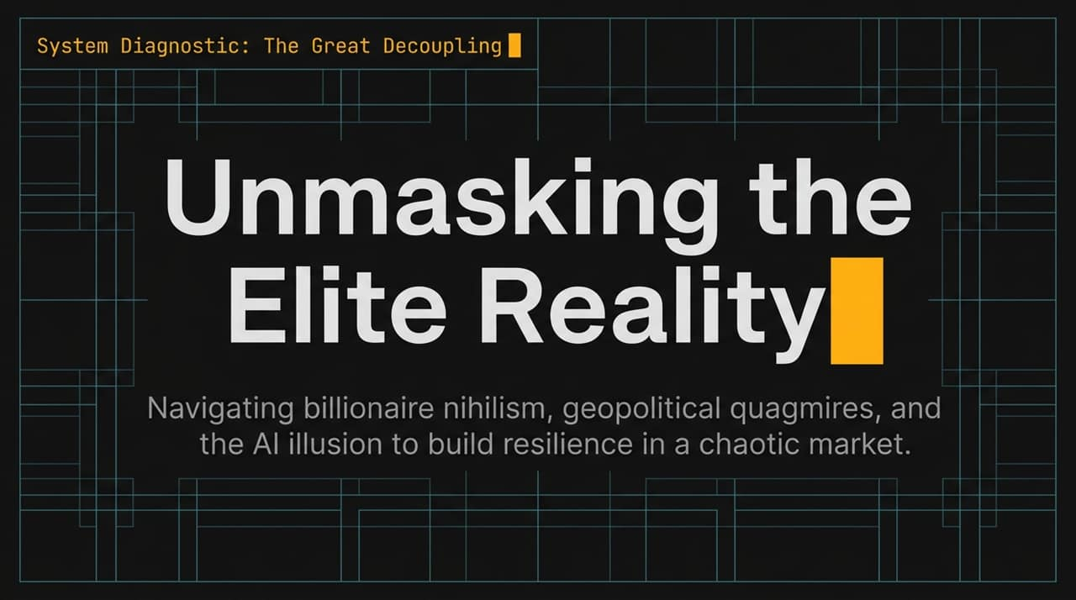
Notes:
Opening Hook: Welcome, everyone. Today we are conducting a system diagnostic on what I call "The Great Decoupling"—unmasking the elite reality and navigating the current landscape of billionaire nihilism, geopolitical instability, and artificial intelligence hype.
Setting the Tone: In the current market, it is easy to get caught up in existential dread or speculative bubbles. Tech founders and Silicon Valley executives tell a story of rapid transformation, but behind the rhetoric lies a very specific economic engine.
Core Goal: Over the next 16 slides, we will navigate four distinct altitudes—from macro geopolitics down to individual playbooks for career, wealth, and purpose. By the end of this presentation, you will have a framework to cut through tech hype, understand economic decoupling, and build personal resilience in a chaotic market
https://www.youtube.com/watch?v=PoXoZCQ8sD0

Slide 2
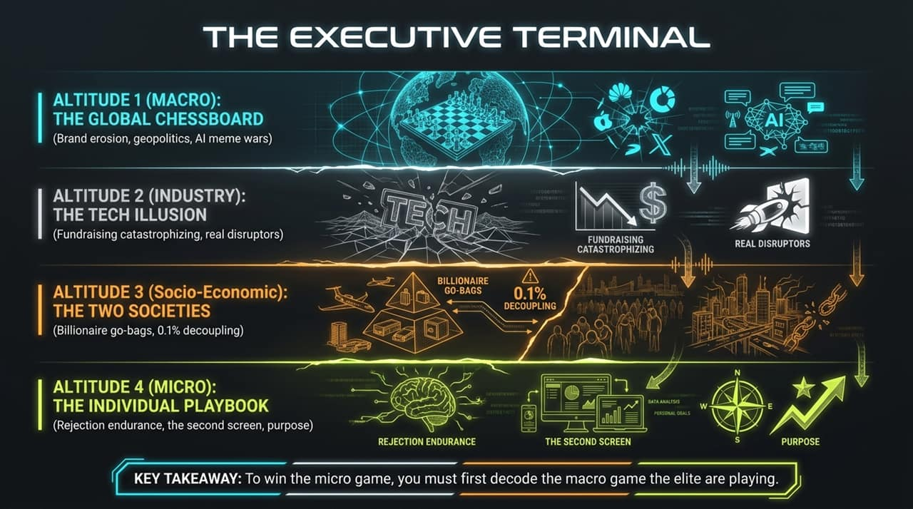
Notes:
Framework Overview: To understand where you stand as an individual or business leader, you have to analyze the environment at four distinct altitudes:
Altitude 1 (Macro): The Global Chessboard. We will look at US brand erosion, international relations, and AI-driven information warfare.
Altitude 2 (Industry): The Tech Illusion. Examining the fundraising catastrophizing flywheel, valuation bubbles, and where real technological disruption actually lives.
Altitude 3 (Socio-Economic): The Two Societies. Deconstructing the decoupling between the top 0.1% and the rest of society, from private security to billionaire "go-bags".
Altitude 4 (Micro): The Individual Playbook. Practical, actionable tactics focusing on rejection endurance, the "Second Screen Protocol," and non-transactional purpose.
Key Takeaway: As noted at the bottom of the terminal: To win the micro game, you must first decode the macro game the elite are playing.

Slide 3
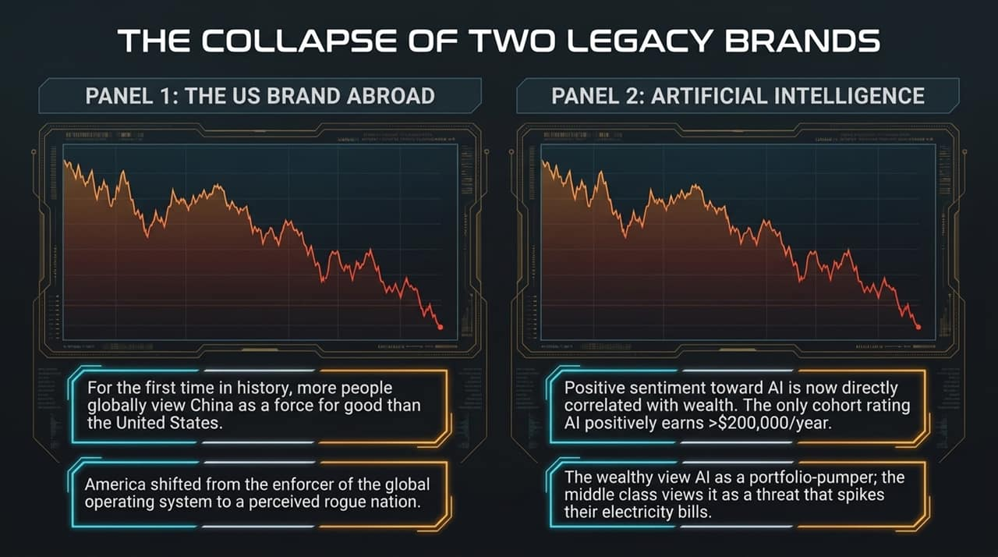
Notes:
The US Brand Abroad: Over the last 18 months, the US brand abroad has suffered severe erosion. Historically, the US was viewed as the enforcer of the global operating system that kept rogue actors in check. Today, perception has shifted dramatically; for the first time in history, global polling shows more people view China as a force for good than the United States.
The AI Brand Collapse: Simultaneously, public perception of Artificial Intelligence has severed into a class divide. Sentiment toward AI is now directly correlated with net worth. The only demographic cohort rating AI positively is individuals earning over $200,000 per year.
Why the Split Exists: High earners see AI as a portfolio-pumper driving S&P growth and personal productivity. The middle class views AI as a threat to job security and a cause for rising utility and electricity bills to power massive data centers.

Slide 4
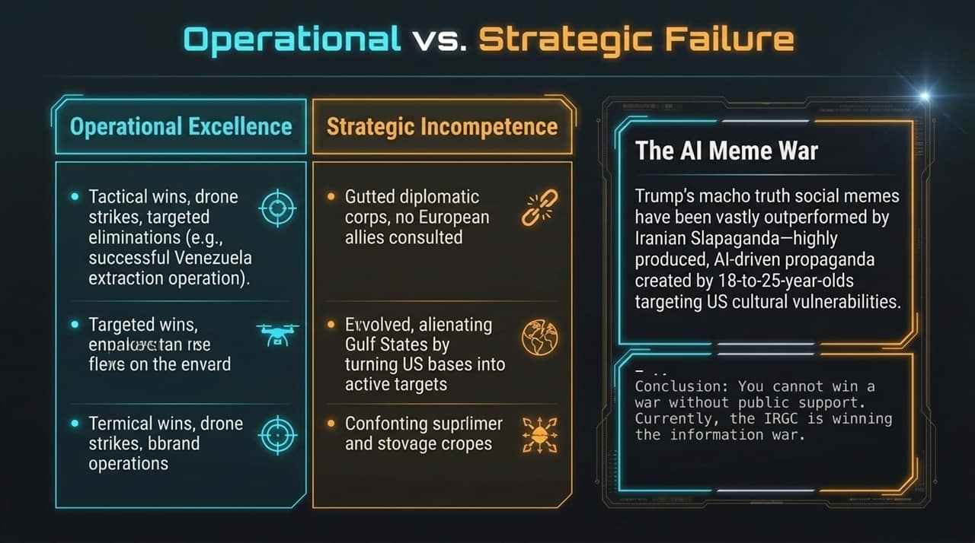
Notes:
Operational vs. Strategic Disconnect: On paper, tactical execution remains high—drone strikes, targeted eliminations, and extraction operations demonstrate operational mastery. However, at the strategic level, diplomacy has withered. Key allies are often sidelined, base locations in the Gulf become reactive targets, and supply chain vulnerabilities persist.
Information Warfare & "Slapaganda": The battle for public support is no longer fought through traditional media. While US political figures rely on traditional social media memes, adversary forces utilize sophisticated, AI-generated propaganda ("Iranian Slapaganda") created by youth demographics targeting cultural fracture lines in the West.
Strategic Reality: Military power is ineffective without public trust and diplomatic alignment. In the modern information ecosystem, narrative control is a primary operational theater.

Slide 5
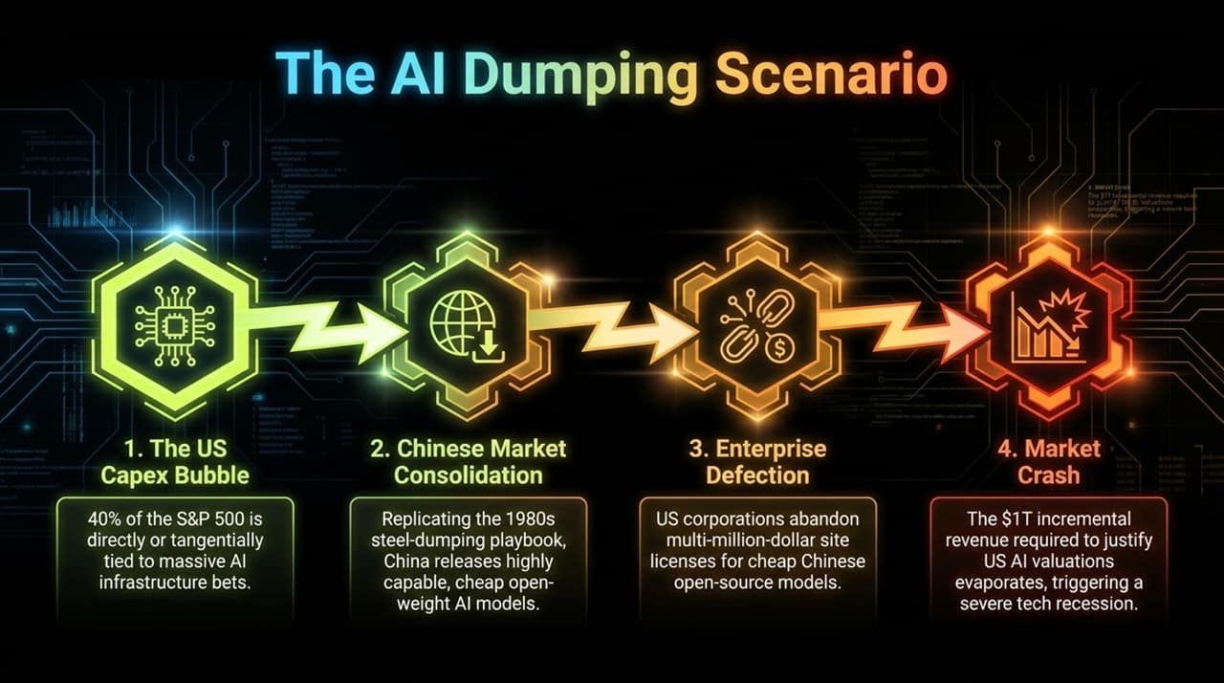
Notes:
The S&P 500 Concentration: Approximately 40% of the S&P 500 value is tied directly or tangentially to massive AI capital expenditures. Tech giants are pouring hundreds of billions into infrastructure, GPUs, and data centers.
The Steel-Dumping Playbook: China is employing a strategy similar to 1980s industrial commoditization. By releasing highly capable, low-cost or free open-weight models, they undermine the pricing power of proprietary US models.
Enterprise Defection: If enterprises realize they can fine-tune open-weight models at a fraction of the cost, multi-million-dollar SaaS site licenses will be canceled.
Valuation Shock: To sustain current market valuations, the US tech ecosystem needs roughly $1 Trillion in incremental revenue. If enterprise capital flows elsewhere, a severe valuation contraction across tech equities could follow.

Slide 6
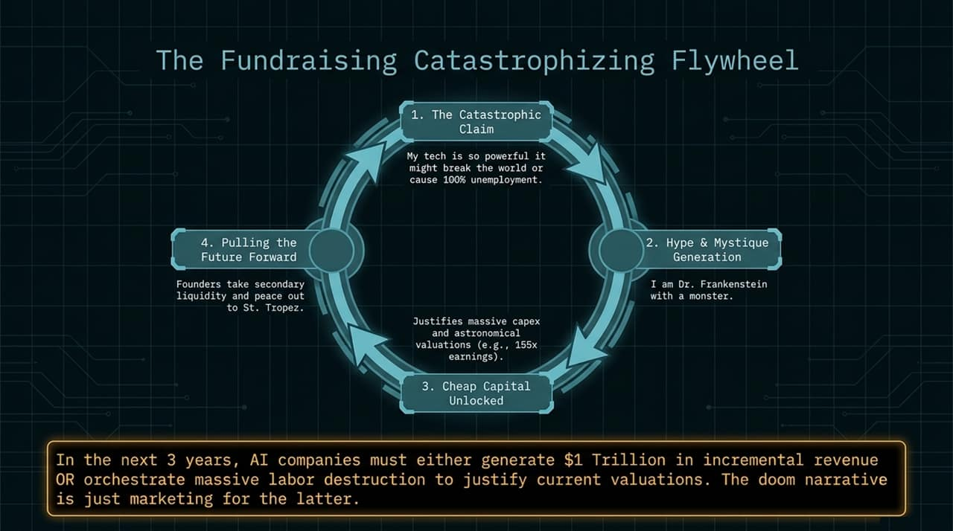
Notes:
The Flywheel Dynamics:
The Catastrophic Claim: AI executives claim their technology is so powerful it will break society or cause total job destruction.
Hype & Mystique: By framing themselves as dangerous visionaries holding unprecedented power, they elevate the perceived value of their models.
Unlocking Cheap Capital: This mystique justifies astronomical valuations (e.g., 155x earnings) and secures massive investment capital.
Secondary Liquidity: Founders take secondary sales during early funding rounds, securing personal wealth regardless of long-term economic returns.
The Math Problem: AI companies must either deliver $1 Trillion in brand-new product revenue or orchestrate massive corporate cost-cutting through labor reduction to justify current prices. The "doomsday narrative" functions in part as a justification for corporate restructuring.

Slide 7
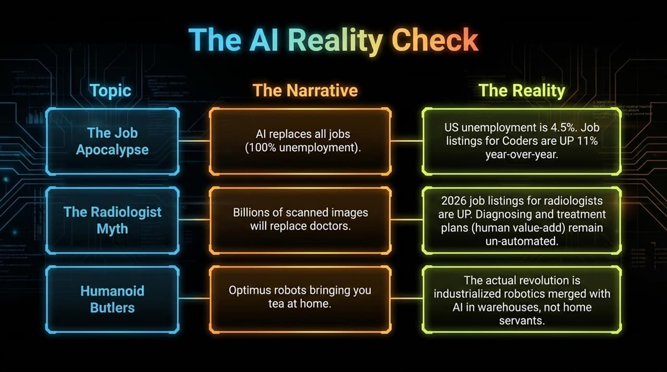
Notes:
Narrative vs. Reality Breakdown:
Claim 1: The Job Apocalypse (100% Unemployment). Reality: US unemployment sits near 4.5%, and job listings for software developers/coders have risen year-over-year. AI automates routine syntax, but demand for high-level architecture remains.
Claim 2: The Radiologist Myth. Reality: Despite predictions that image recognition would render radiologists obsolete, job postings for radiologists are up. Image analysis is only one component of medical care; diagnosis integration, patient care, and treatment execution require human oversight.
Claim 3: Humanoid Butlers. Reality: Consumer humanoid robots serving drinks in homes remain impractical marketing concepts. Real technological adoption is occurring in industrial automation—such as automated logistics and warehouse management.

Slide 8
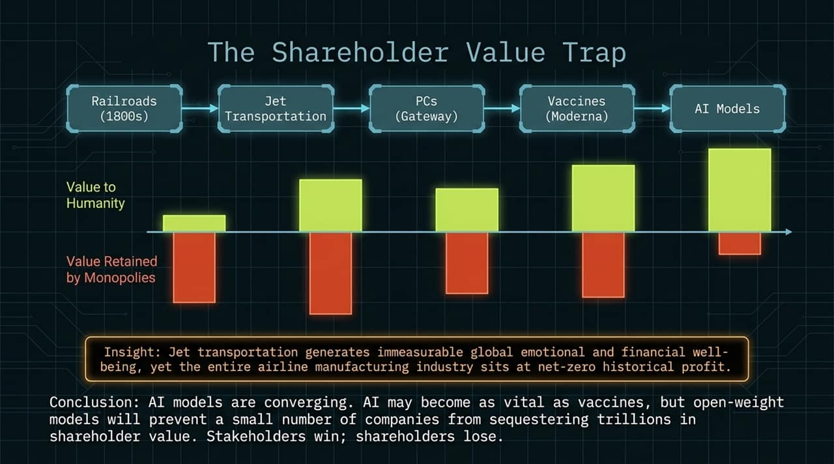
Notes:
Historical Precedent: Consider commercial jet aviation. Jet transportation transformed global commerce, connectivity, and societal well-being. Yet, historically, the aggregate airline manufacturing and airline carrier sector has generated near net-zero cumulative economic profit due to intense competition and capital intensity.
Value Creation vs. Value Capture: Similar patterns appear across railroads, personal computing hardware, and vaccines. Essential innovations create widespread public utility, but competition prevents single actors from capturing all economic rent.
The AI Convergence: As open-weight models improve, baseline LLMs commoditize. AI will drive immense societal productivity, but open-source access will distribute that value to society rather than concentrating trillions into a handful of closed software monopolies.

Slide 9
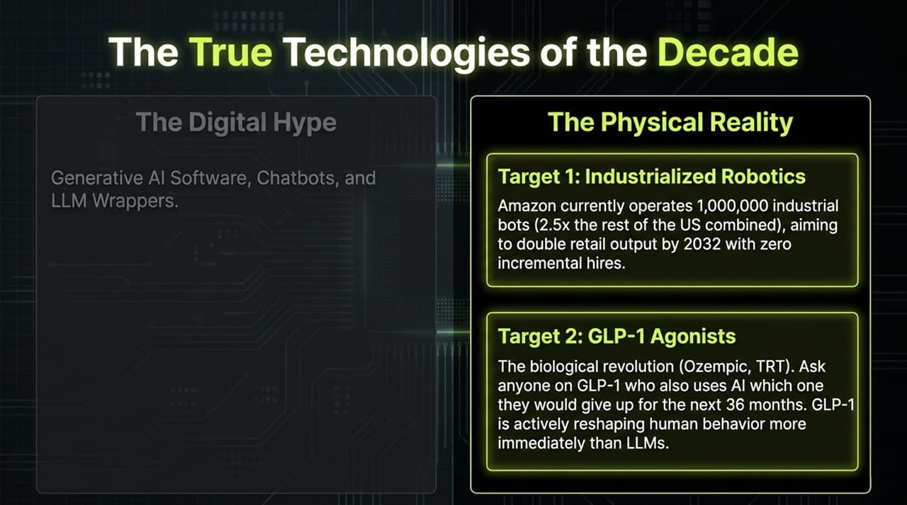
Notes:
Digital Hype vs. Physical Reality: While headlines focus on consumer chatbots and LLM wrappers, the most transformative technological shifts are occurring in hardware logistics and human biology.
Industrialized Robotics: Amazon currently deploys over 1,000,000 industrial warehouse robots—representing more automated units than the rest of the US private sector combined. The operational goal is scaling output without linear headcount growth.
GLP-1 Agonists & Biological Tech: Metabolic drugs (e.g., Ozempic, Wegovy) represent an immediate behavioral shift. They alter consumer spending, food consumption, addiction pathways, and long-term healthcare dynamics faster and more directly than generative writing tools.

Slide 10
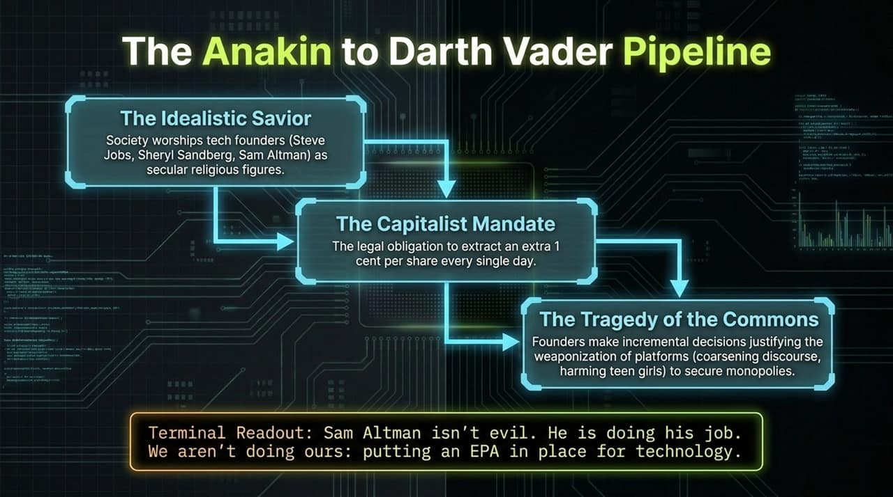
Notes:
The Archetype Cycle: Society frequently elevates tech founders into celebrated figures promised to solve complex human challenges.
The Fiduciary Mandate: Public and venture-backed corporate structures legally compel executives to maximize shareholder value. Incremental business decisions prioritize engagement, monetization, and market expansion.
Tragedy of the Commons: Systemic externalities—such as algorithmic polarization or mental health impacts on adolescents—are often treated as acceptable trade-offs for corporate growth.
Systemic Solution: Individual tech executives act according to corporate incentives. The issue is not individual intent, but the absence of regulatory frameworks ("an EPA for technology") to guard public welfare.

Slide 11
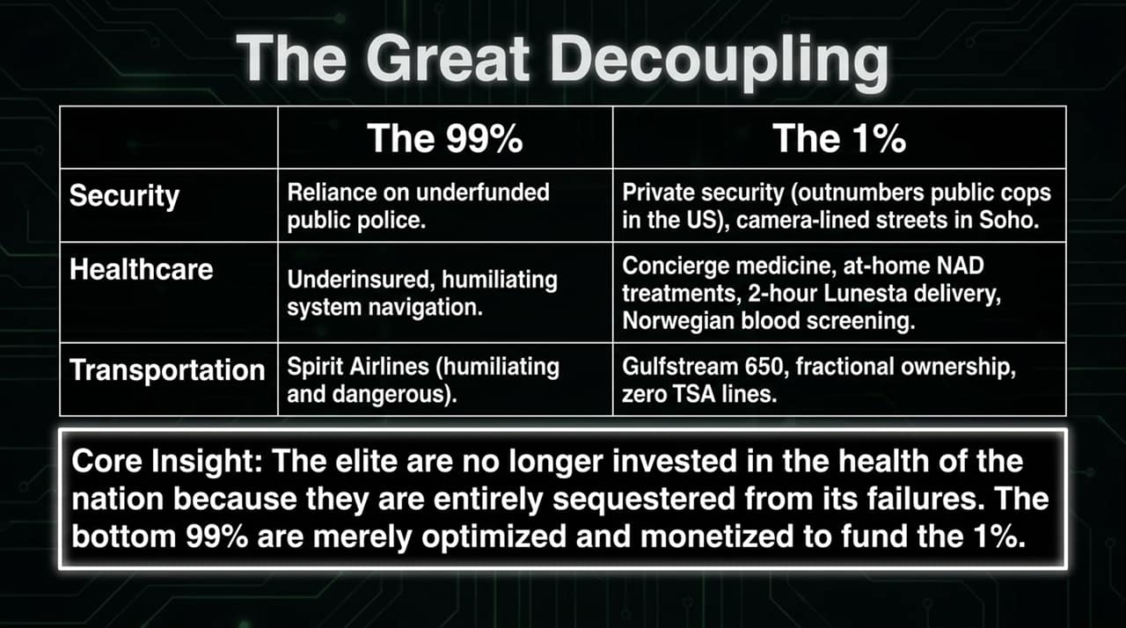
Notes:
Divergence Across Daily Life:
Security: Public law enforcement faces budget constraints, while private security networks and monitored enclaves protect affluent urban corridors.
Healthcare: Navigating complex, underinsured public health systems versus private concierge medicine, localized diagnostics, and specialized therapies.
Transportation: Commercial air travel friction versus private aviation and dedicated transport infrastructure.
The Structural Risk: When the top tier of wealth can bypass shared public infrastructure, systemic commitment to maintaining civic services declines. The broader population is treated primarily as a user base to be monetized.

Slide 12
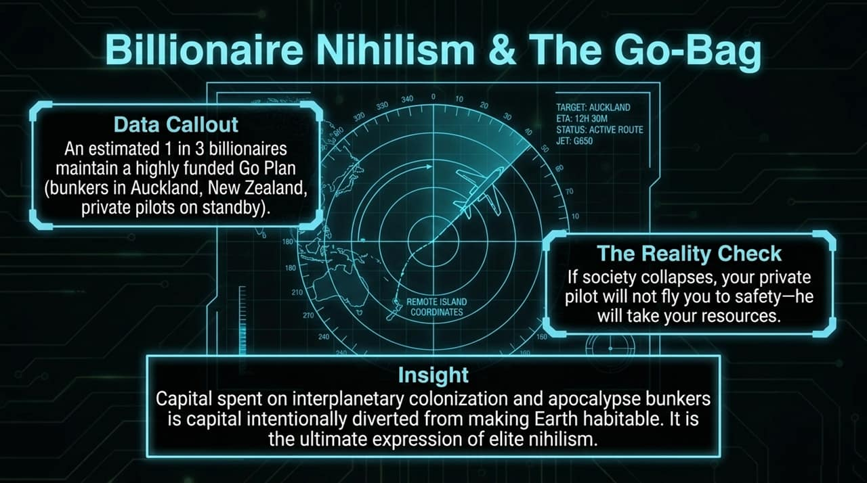
Notes:
The Go-Plan Trend: Roughly one-third of ultra-high-net-worth individuals maintain active contingency plans—including remote real estate, private flight arrangements, and specialized residency provisions.
The Logical Flaw: Contingency plans relying on private staff or isolated shelters assume institutional structures remain intact during severe collapse. In real systemic breakdowns, contract enforcement and loyalty disintegrate.
Elite Nihilism: Allocating capital toward off-grid survivalism or speculative off-planet migration reflects a retreat from civic investment. Capital spent preparing for collapse is capital diverted from maintaining stable, functioning societies on Earth.

Slide 13
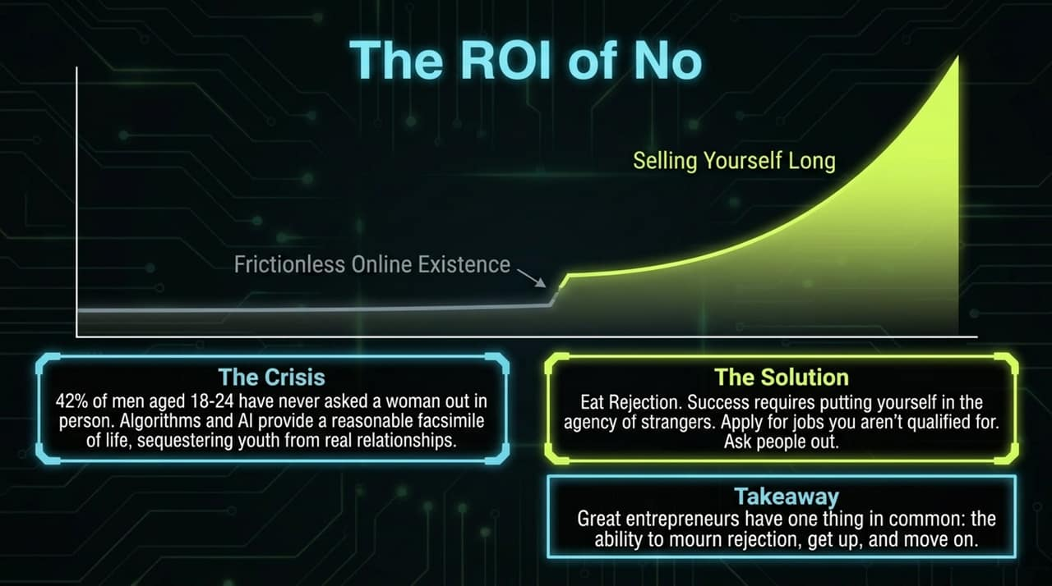
Notes:
The Isolation Friction: Digital algorithms provide simulated interaction without social friction. Over 40% of young men aged 18–24 report never initiating an in-person romantic conversation.
The Power of Rejection: Professional and personal growth requires willingness to encounter rejection. Applying for challenging positions, pitching ideas, and engaging directly with strangers builds emotional tolerance.
Core Takeaway: Career trajectories are built on resilience—the capacity to process setbacks, adapt, and proceed.

Slide 14
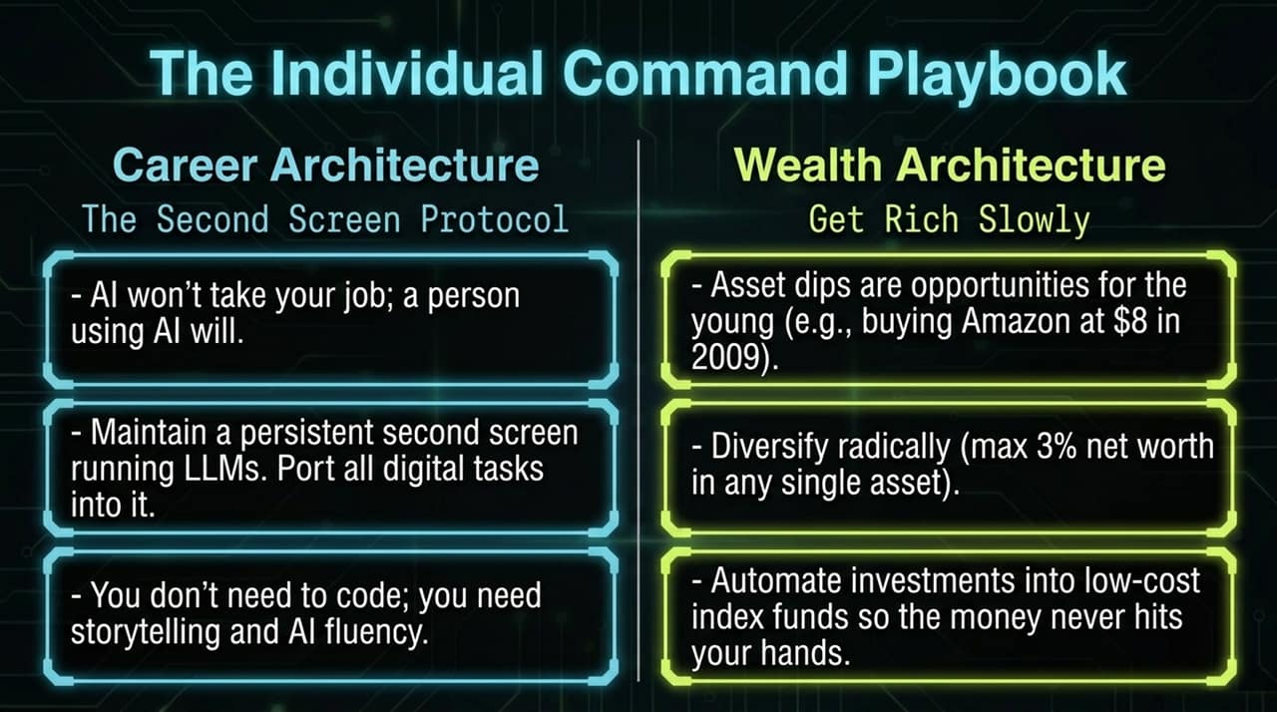
Notes:
Career Architecture & The Second Screen Protocol:
AI tools will not eliminate professionals automatically; rather, professionals who leverage AI will outperform those who do not.
Establish a "second screen" workspace running local or cloud LLMs to streamline routine tasks, data processing, and research.
Focus on communication, narrative design, and tech integration rather than purely technical coding syntax.
Wealth Architecture:
Patience: Build wealth steadily through disciplined, low-cost index investing.
Risk Mitigation: Maintain broad diversification, limiting single-asset exposure.
Capital Utilization: Treat market downturns as acquisition opportunities rather than reasons for panic.

Slide 15
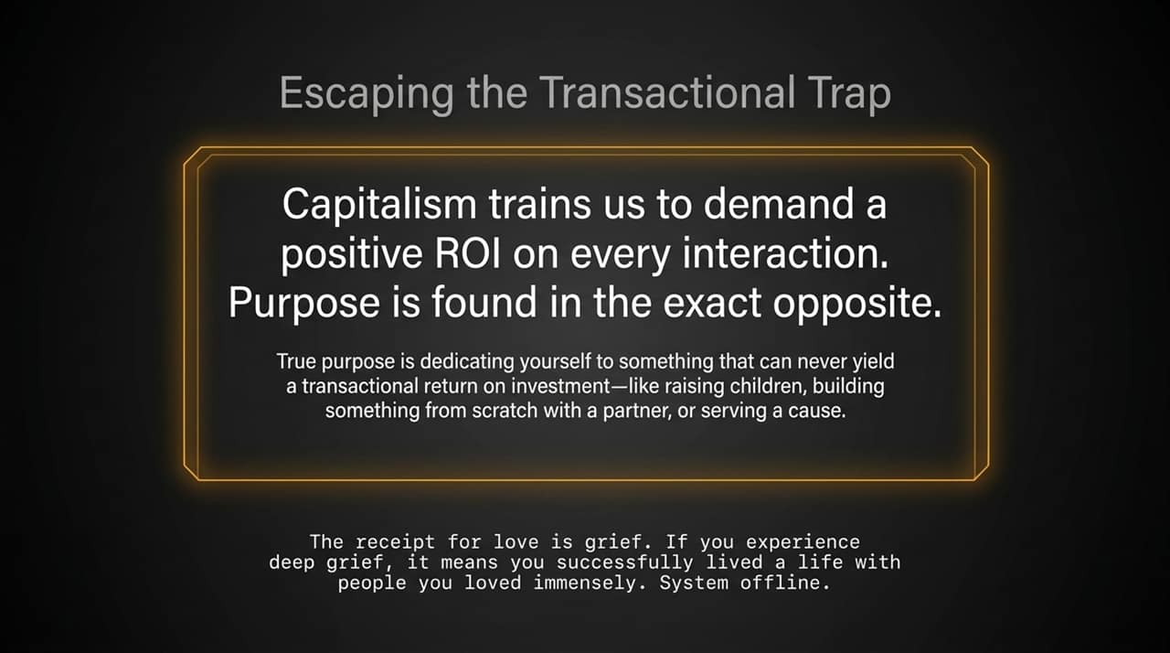
Notes:
he Transactional Illusion: Modern market culture measures activities through immediate return on investment. Applying strict transactional metrics to personal relationships leads to isolation.
Non-Transactional Purpose: Meaningful commitments—raising families, mentoring others, sustaining long-term partnerships, or contributing to civic causes—do not yield standard financial metrics.
Closing Perspective: Emotional attachment carries inherent vulnerability. Experiencing profound grief or loss is evidence of deep engagement with life and meaningful connections with others.

Slide 16
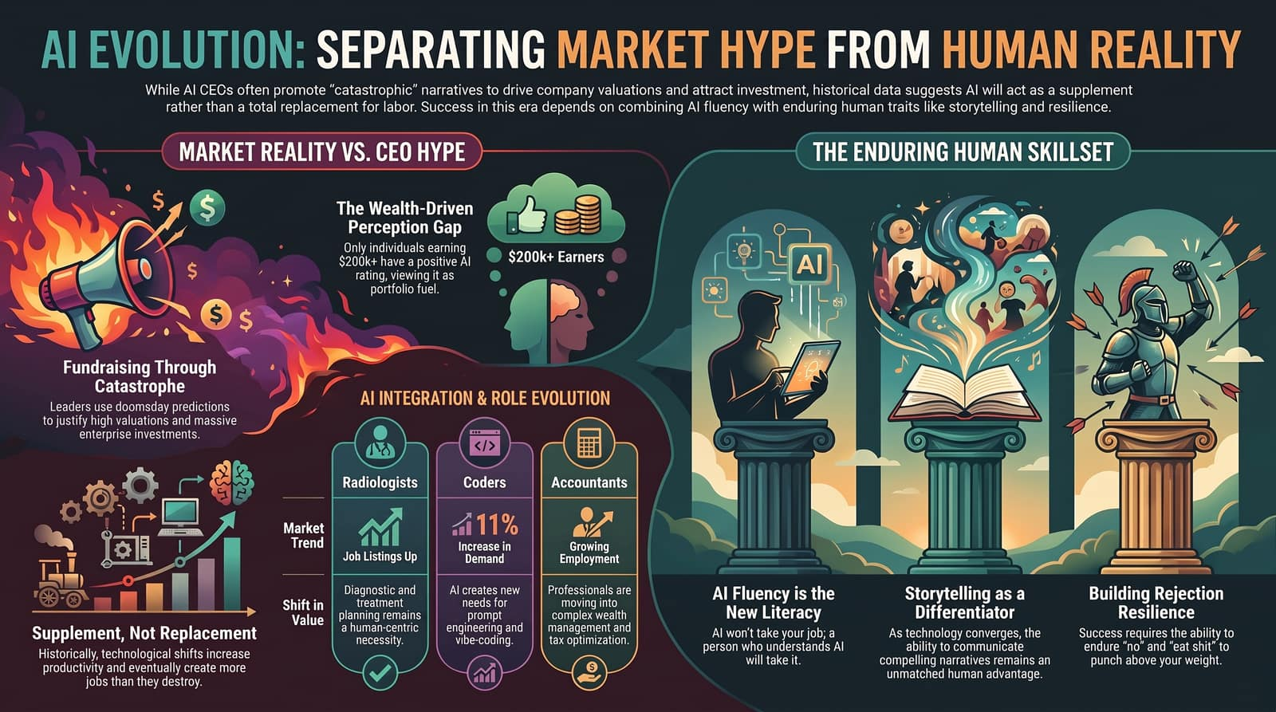
Notes:
Market Perception vs. Operational Reality:
Tech executives often leverage elevated predictions to secure capital and sustain high multiples.
High earners view AI as an equity driver, while middle-income workers encounter rising costs and operational changes.
Professional Evolution:
Accountants & Analysts: Shifting from manual record-keeping to strategic planning and advisory services.
Radiologists: Utilizing automation for initial image screening while concentrating on diagnostic synthesis and patient care.
Developers: Expanding from writing line-by-line syntax to managing system architecture, prompt structures, and integration.
The Core Human Skillset:
AI Fluency: Fluency with modern technical tools is a baseline requirement.
Narrative & Communication: As technical capabilities democratize, clear storytelling and persuasive framing remain high-value skills.
Resilience: The capacity to endure rejections and adapt through structural changes remains the definitive competitive advantage.

